Slide 1

13Reasons.py
Presented by:
Claudia Ahrens
Ganesh Gurunathan
Kaylin McLeod
Janet Namulondo
William Taborn

Slide 2
Project Background
Mental health and substance abuse has had a near ever-present position in the news lately:
Opioid crisis
Criminal profiling
Legalization of cannabis
Studies: One of the first and most prominent -- National Institute of Mental Health’s Epidemiological Catchment Area published in 1990 (2nd analysis in 1994)
Ultimately disproves a causation relationship between mental illness/substance abuse and violence
Higher results in psychiatric disorders comparatively

Slide 3
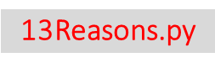
Motivation and Summary
Difference between the mental health facilities and substance abuse facilities.
Do the types of mental health and substance resources correlate to higher or lower crime rates?
Do geographic areas with less access mental health and substance abuse resources have greater crime rates?
Team interest in the topic
Accessible data sets
Motivation and Summary | Questions and Data | Data Cleanup and Exploration | Data Analysis | Discussion | Post Mortem | Questions
Motivation and Summary | Questions and Data | Data Cleanup and Exploration | Data Analysis | Discussion | Post Mortem | Questions

Slide 4
Motivation and Summary
13Reasons.py
Null Hypothesis – The lack of access to mental health and substance abuse support facilities has no effect on crime rates.
We were unable to disprove our null hypothesis based on the analysis we completed.
Motivation and Summary | Questions and Data | Data Cleanup and Exploration | Data Analysis | Discussion | Post Mortem | Questions
Motivation and Summary | Questions and Data | Data Cleanup and Exploration | Data Analysis | Discussion | Post Mortem | Questions

Slide 5
Motivation and Summary
There is a broad range of crime totals associated with states that have both high and low counts of mental health and substance abuse facilities.
A state with one of the highest reported crime counts also had the largest number of facilities - Arkansas.
The state of Texas was near the US Crime Average at but was well below the us facility count average.
Motivation and Summary | Questions and Data | Data Cleanup and Exploration | Data Analysis | Discussion | Post Mortem | Questions
Motivation and Summary | Questions and Data | Data Cleanup and Exploration | Data Analysis | Discussion | Post Mortem | Questions

Slide 6
Questions and Data
13Reasons.py
Behavioral health treatments and services:
Facilities that help people with common mental illnesses and substance use disorders.
source: https://www.samhsa.gov
Crime:
Violent Crime, Homicide, Rape, Robbery, Aggravated Assault, Property Crime, Burglary, Larceny, Motor Vehicle Theft, and Arson As reported by the FBI
source: https://api.usa.gov/crime/fbi/sapi/api/summarized/estimates/states/TX/2017/2017?API_KEY=
Motivation and Summary | Questions and Data | Data Cleanup and Exploration | Data Analysis | Discussion | Post Mortem | Questions

Slide 7
Questions and Data
13Reasons.py
Federal Crime Data API Link:
We used UCR data, which is a collection of all data reported by agencies, either the agency report based on SRS or NIBRS format.
API Link:
https://api.usa.gov/crime/fbi/sapi/api/estimates/states/{state}/{yearSince}/{yearUntil}?API_KEY=
On initial data retrieval difficulty, we had the data retrieved from SRS which is a legacy reporting format, and neither SRS or NIBRS gives the complete State data.
But with the use of UCR , we where able to get combined data, and at the state level.
Motivation and Summary | Questions and Data | Data Cleanup and Exploration | Data Analysis | Discussion | Post Mortem | Questions

Slide 8
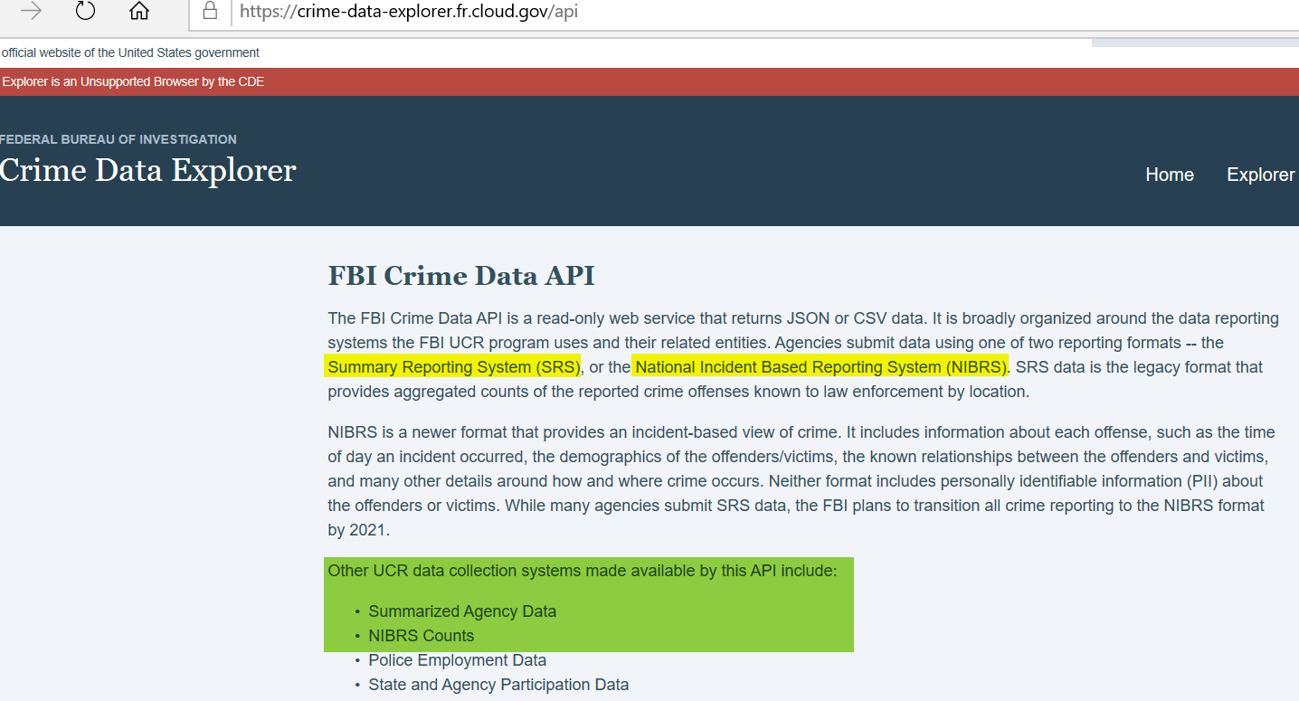
Questions and Data
13Reasons.py
Motivation and Summary | Questions and Data | Data Cleanup and Exploration | Data Analysis | Discussion | Post Mortem | Questions

Slide 9
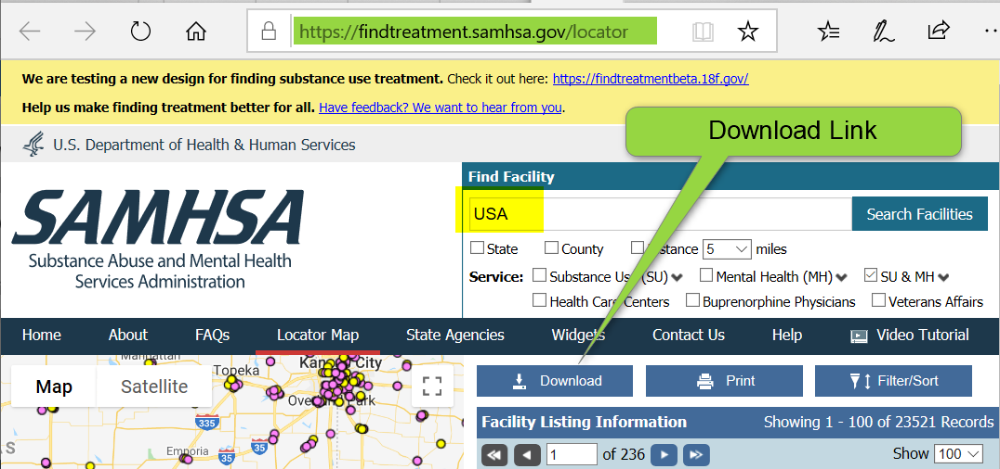
Questions and Data
13Reasons.py
Motivation and Summary | Questions and Data | Data Cleanup and Exploration | Data Analysis | Discussion | Post Mortem | Questions

Slide 10
Data Cleanup & Exploration
13Reasons.py
Crime Data Challenges
Multiple FBI crime APIs with limited documentation
Agency reporting old versus new format
Crime count variances
Crime date - latest reported by FBI & alignment with SAMSHA data
SAMHSA Facility Data Challenges
Missing state addresses
No historical data
Motivation and Summary | Questions and Data | Data Cleanup and Exploration | Data Analysis | Discussion | Post Mortem | Questions

Slide 11
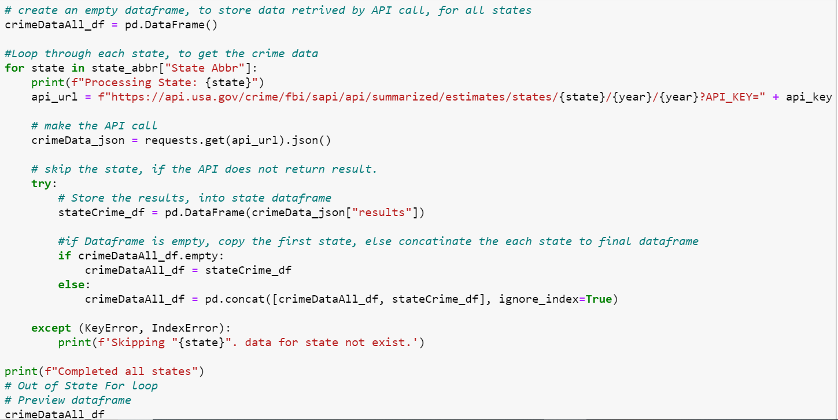
Data Cleanup & Exploration API is called, and the DataFrame for crime data is created
13Reasons.py
Motivation and Summary | Questions and Data | Data Cleanup and Exploration | Data Analysis | Discussion | Post Mortem | Questions

Slide 12
Data Cleanup & Exploration
13Reasons.py
Data Standardization.
To compare States based on Facility and Crime Count, each of the data needed to be brought to the same scale.
For that we came up with the conversion of “facility count per 100,000 individuals” and “Crime count per 100,000 individuals”
Motivation and Summary | Questions and Data | Data Cleanup and Exploration | Data Analysis | Discussion | Post Mortem | Questions

Slide 13
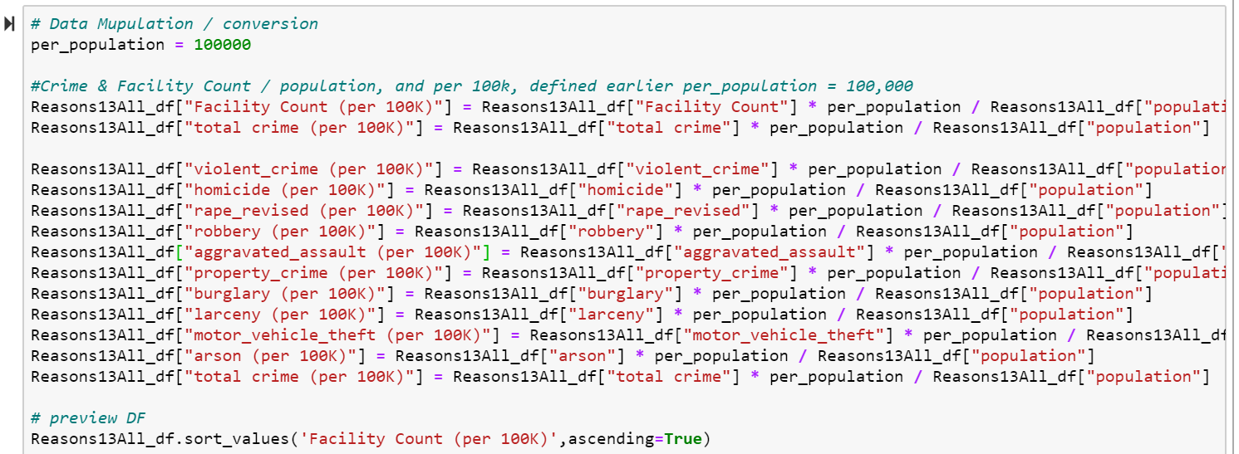
Data Cleanup & Exploration
13Reasons.py
"Count per 100K" = ("Count" / "Population") * 100,000
Motivation and Summary | Questions and Data | Data Cleanup and Exploration | Data Analysis | Discussion | Post Mortem | Questions

Slide 14
Data Cleanup & Exploration
13Reasons.py
Crime data from API was for last 40 years, and even with the API parameter of year, it brought in all 40 years of data. so we had to filter it to just 2017.
Motivation and Summary | Questions and Data | Data Cleanup and Exploration | Data Analysis | Discussion | Post Mortem | Questions

Slide 15
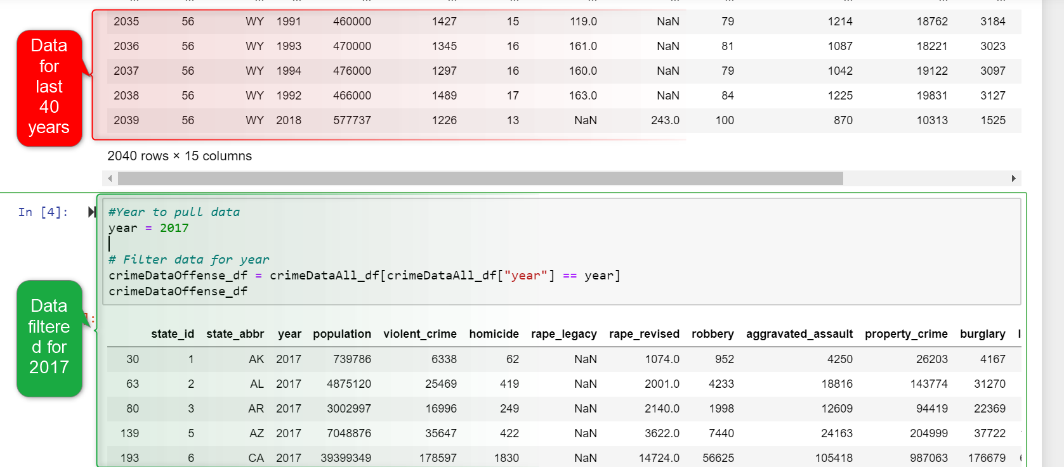
Data Cleanup & Exploration
13Reasons.py
Motivation and Summary | Questions and Data | Data Cleanup and Exploration | Data Analysis | Discussion | Post Mortem | Questions

Slide 16
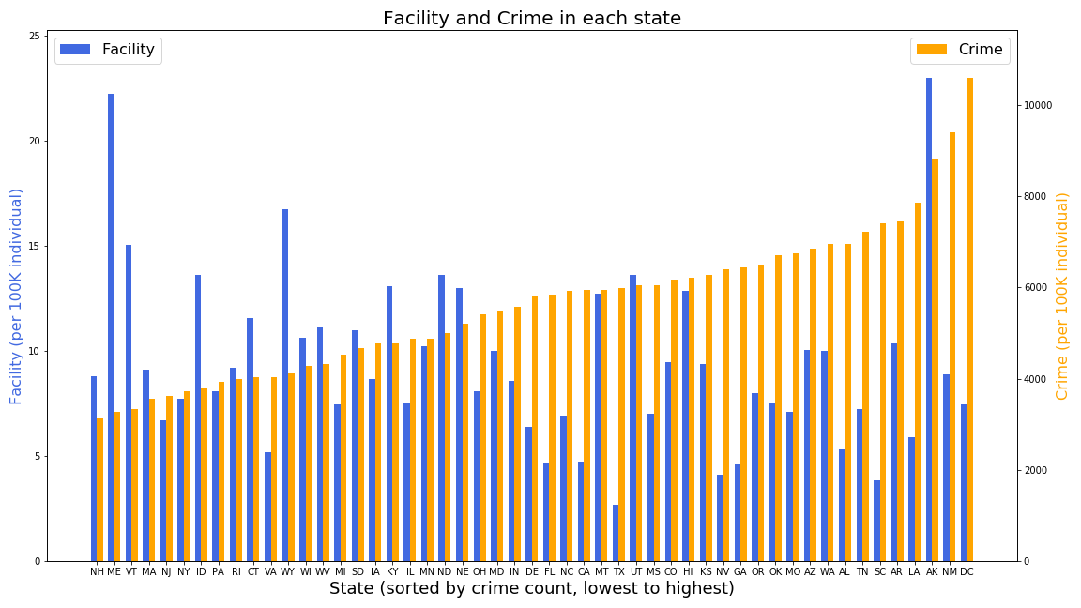
Data Analysis
13Reasons.py
Motivation and Summary | Questions and Data | Data Cleanup and Exploration | Data Analysis | Discussion | Post Mortem | Questions

Slide 17
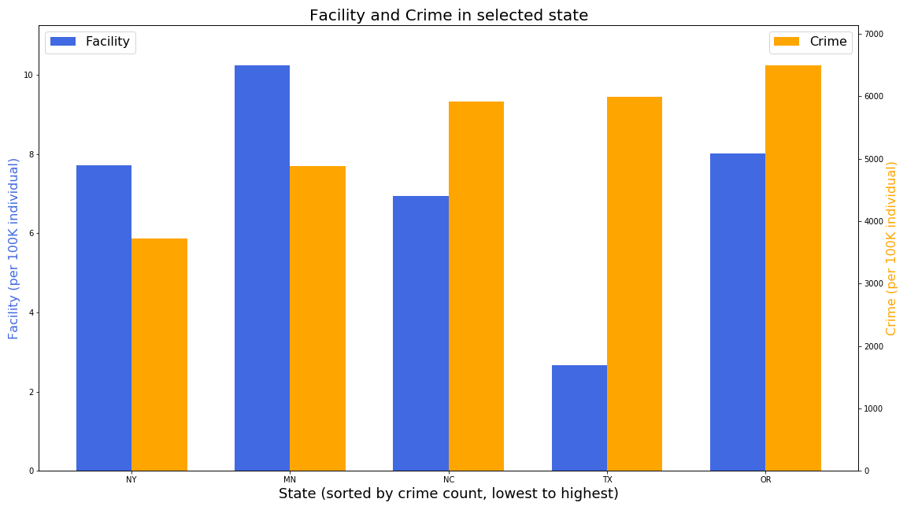
Data Analysis
13Reasons.py
Motivation and Summary | Questions and Data | Data Cleanup and Exploration | Data Analysis | Discussion | Post Mortem | Questions

Slide 18
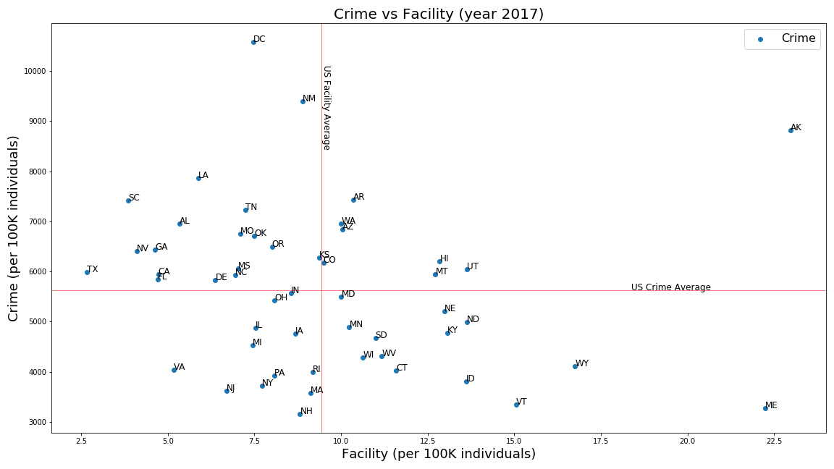
Data Analysis
13Reasons.py
Motivation and Summary | Questions and Data | Data Cleanup and Exploration | Data Analysis | Discussion | Post Mortem | Questions

Slide 19
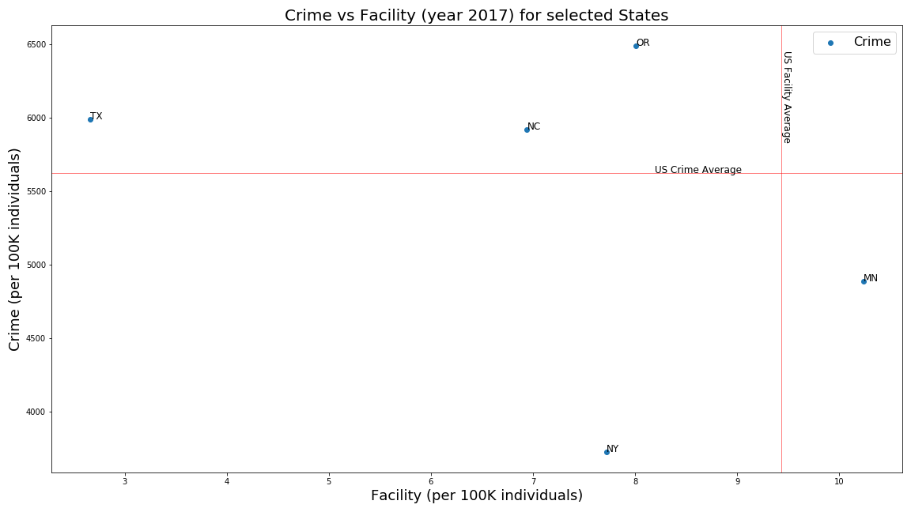
Data Analysis
13Reasons.py
Motivation and Summary | Questions and Data | Data Cleanup and Exploration | Data Analysis | Discussion | Post Mortem | Questions

Slide 20
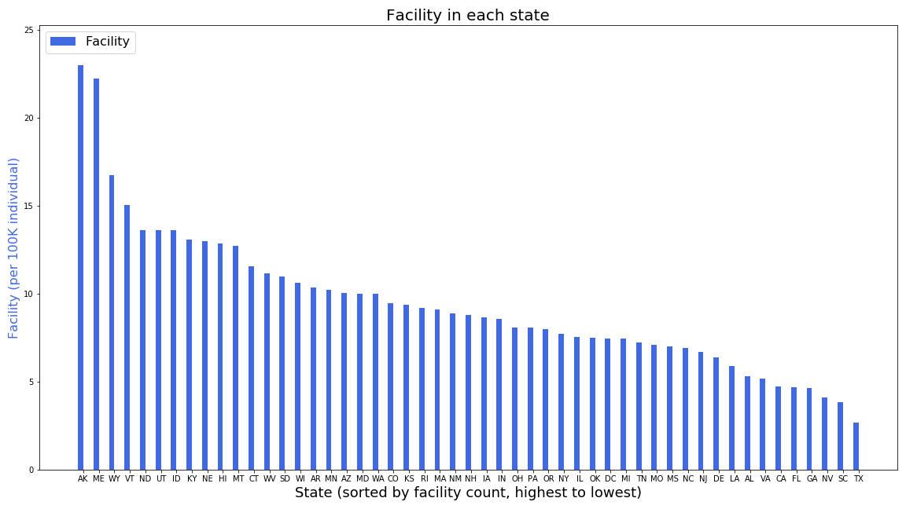
Data Analysis
13Reasons.py
Motivation and Summary | Questions and Data | Data Cleanup and Exploration | Data Analysis | Discussion | Post Mortem | Questions

Slide 21
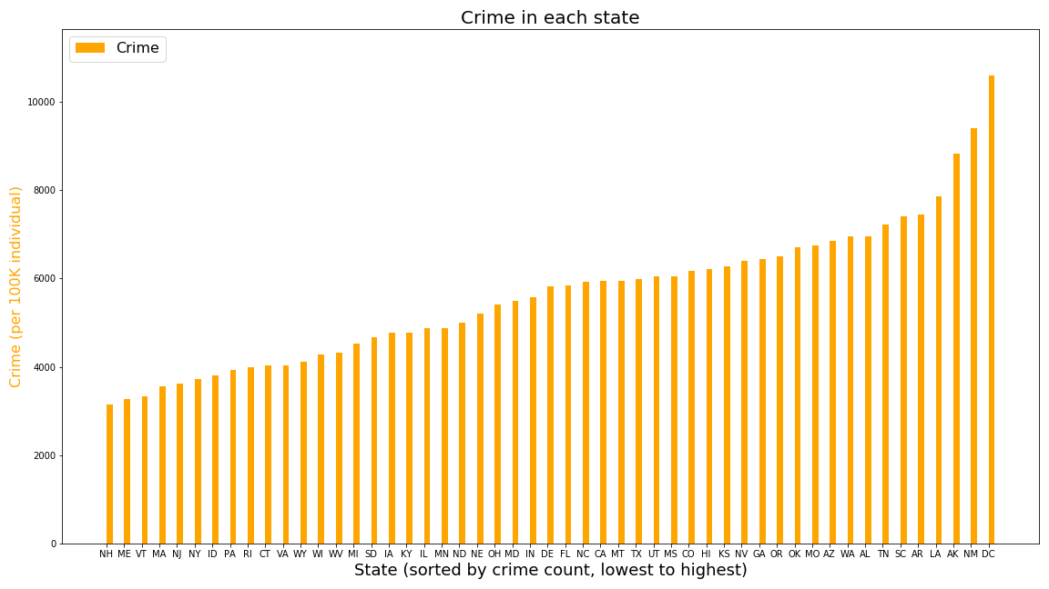
Data Analysis
13Reasons.py
Motivation and Summary | Questions and Data | Data Cleanup and Exploration | Data Analysis | Discussion | Post Mortem | Questions

Slide 22
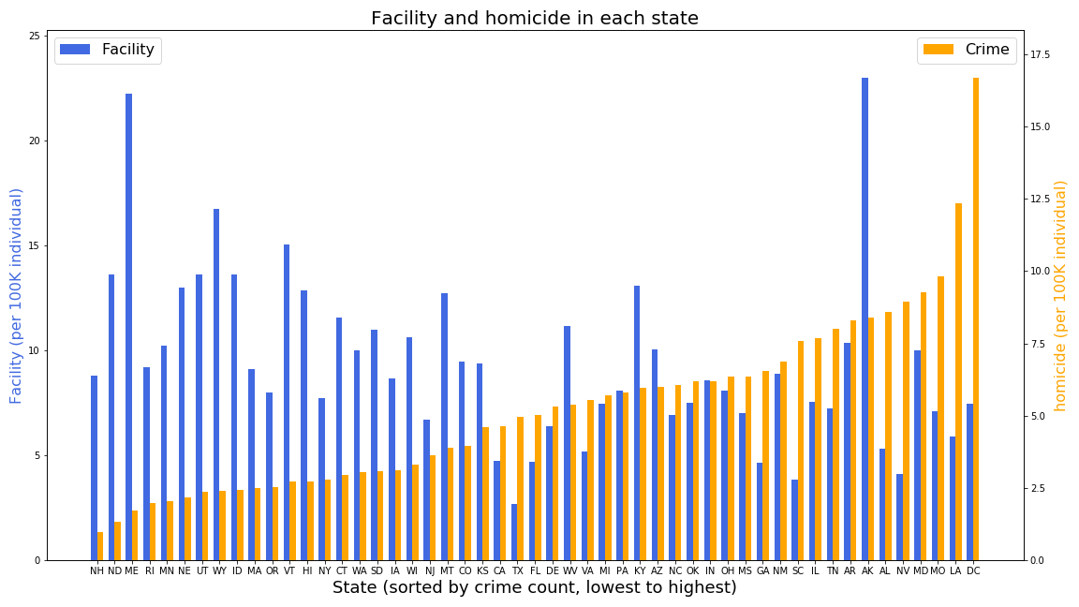
Data Analysis
13Reasons.py
Motivation and Summary | Questions and Data | Data Cleanup and Exploration | Data Analysis | Discussion | Post Mortem | Questions

Slide 23
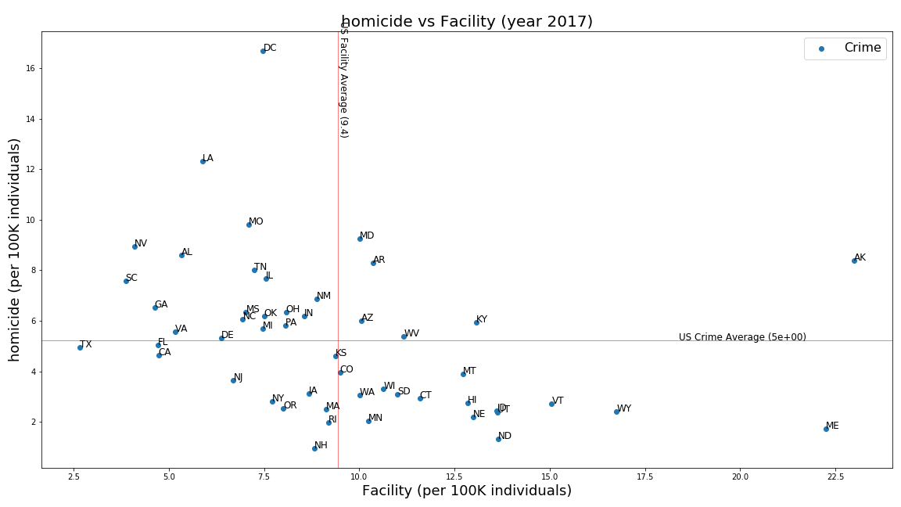
Data Analysis
13Reasons.py
Motivation and Summary | Questions and Data | Data Cleanup and Exploration | Data Analysis | Discussion | Post Mortem | Questions

Slide 24
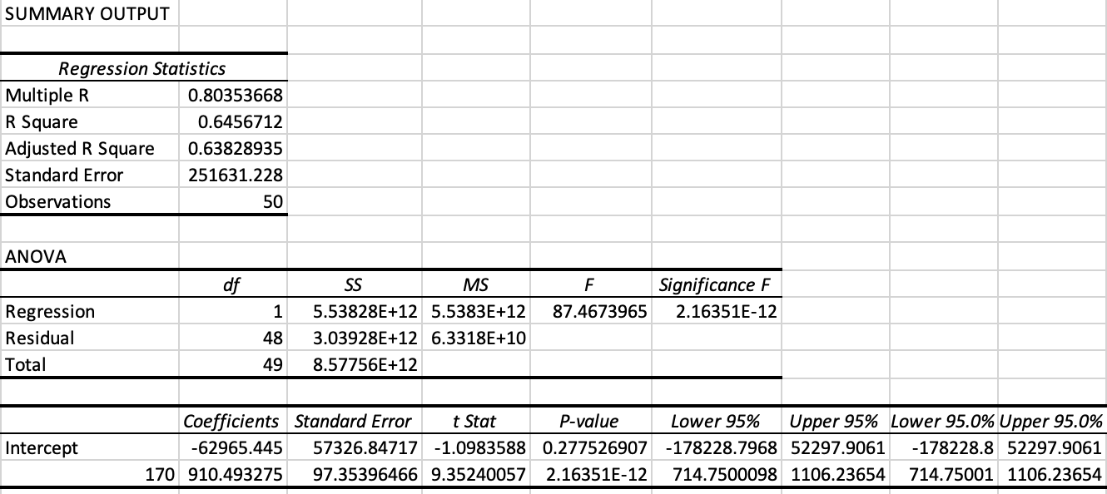
Discussion
13Reasons.py
Regression Analysis
Motivation and Summary | Questions and Data | Data Cleanup and Exploration | Data Analysis | Discussion | Post Mortem | Questions

Slide 25
Discussion
Expectations
An inverse relationship between number of MH and SA facilities and the rate of crime
Inferences/Conclusions
Most states’ facilities and crime rates were largely concentrated around the average
We were unable to disprove the null hypothesis that lack of access to mental health and substance abuse support facilities has no effect on crime rates
Motivation and Summary | Questions and Data | Data Cleanup and Exploration | Data Analysis | Discussion | Post Mortem | Questions

Slide 26
Conclusions
Correlation coefficient (Multiple R) shows a strong positive correlation between the means
R Square: Over 60% of the variance between facilities and total crime are related
P Value indicated statistical significance
Correlation is not causation

Slide 27
Post Mortem
13Reasons.py
SAMHSA list of facilities are only those that are registered with the organization (decided to make that our scope)
2. Trying to better define the scope of the project to decide:
a. Should we include the entire United States
b. How to define accessibility to facilities (number of facilities within a certain mile radius of a city)
c. How to define an area with great/poor access to resources
d. Scaling the scope down from all the types of resources available to MH and SA facilities
Motivation and Summary | Questions and Data | Data Cleanup and Exploration | Data Analysis | Discussion | Post Mortem | Questions

Slide 28
Post Mortem
13Reasons.py
Defining the crimes that will be included within the scope (major, minor, violent, etc.) - decided to use FBI Crime Data Explorer's list of offenses as criteria
Standardization of the data based on population, crime and facility per 100k
Motivation and Summary | Questions and Data | Data Cleanup and Exploration | Data Analysis | Discussion | Post Mortem | Questions

Slide 29
Post Mortem
13Reasons.py
Discuss any additional questions that came up, but which you didn't have time to answer: What would you research next, if you had two more weeks?
Our scope would have been redefined.
Merged with Longitudes/Latitudes versus State
Additional mental health and substance abuse resources
Motivation and Summary | Questions and Data | Data Cleanup and Exploration | Data Analysis | Discussion | Post Mortem | Questions

Slide 30
QUESTIONS
13Reasons.py
Open-floor Q&A with the audience
13Reasons.py
Motivation and Summary | Questions and Data | Data Cleanup and Exploration | Data Analysis | Discussion | Post Mortem | Questions

